Slide 1

MSC ECONOMICS (DATA ANALYTICS) · BIG DATA ANALYTICS
Pricing the Streets
Congestion Pricing, Relative Prices and the Taxi Market
An empirical analysis of NYC Yellow Taxi data, 2022–2025
[Student name]
[Programme] · [Institution] · [Presentation date]
Notes:
Opening. The background is an original illustration of a New York yellow taxi; to use a real photograph instead, right-click it and choose Change Picture (the dark overlay stays on top). Introduce the project: New York’s yellow-taxi records from 2022 to 2025 let us study two price changes, the December 2022 fare increase and the January 2025 congestion charge.

Slide 2
Why price the streets?
A · INTRODUCTION
Congestion is a classic externality: each extra car slows everyone else, but roads are free at the point of use.
Road pricing charges drivers when and where roads are busiest, so the trips that remain move faster.
Taxis as sensors: every yellow-taxi trip records its time and distance, so millions of trips reveal how fast the city moves and how much people ride.
Cities that priced their roads
1975
Singapore
First area licence scheme
2003
London
£5 daily central-zone charge
2006
Stockholm
Time-varying cordon toll
157.9M
2
New York
First in the United States: this study
2025
taxi trips, 2022–2025
price changes studied
Notes:
Introduction. Congestion wastes time, fuel and clean air, and roads are usually free at the point of use, so each driver ignores the delay they impose on others. Economists have long argued for charging for road use when it is busiest. Few cities have done it: Singapore in 1975, London in 2003, Stockholm in 2006, and New York in January 2025, the first in the United States. New York also publishes every taxi trip, so 157.9 million yellow-taxi trips can act as a citywide network of speed sensors. This project uses them to study the congestion charge and the earlier 2022 fare increase, and asks what Indian cities can learn.

Slide 3
Two price shocks hit New York’s taxi market in three years
A · POLICY CONTEXT
Study window: Jan 2022 – Dec 2025
2022
2023
2024
2025
19 DEC 2022
5 JAN 2025
Taxi fare increase
Congestion pricing
+23–35%
Flag drop $2.50 → $3.00
Per mile $2.50 → $3.50
JFK flat fare $52 → $70
Higher rush-hour and night surcharges
$9
Zone: Manhattan at and below 60th St
Taxi passengers pay $0.75 per trip
Uber and Lyft passengers pay $1.50
FDR Drive and West Side Highway exempt
rise in mean meter fare by trip type
peak toll per car per day ($2.25 overnight)
Notes:
Two events. On 19 December 2022 the TLC raised yellow-taxi fares for the first time in a decade: the flag drop from $2.50 to $3.00, the distance rate from $2.50 to $3.50 a mile, higher rush-hour and night surcharges, and the JFK flat fare from $52 to $70. On 5 January 2025 New York introduced congestion pricing in Manhattan at and below 60th Street: $9 for cars at peak, $2.25 overnight, and $0.75 per taxi trip. Both change what a taxi trip costs relative to its alternatives, so they are natural experiments for taxi demand, trip patterns and street speeds. Check fare figures against the TLC notice before presenting.

Slide 4

A · RESEARCH PROBLEM
How did the taxi market adjust when relative prices changed?
1
Transport costs
2
Relative prices
A trip’s cost is its fare plus the time it takes. Less congestion lowers the time cost for every road user.
The toll raises the cost of driving ($9) far more than a taxi trip ($0.75): taxis became relatively cheaper.
3
Consumer behaviour
4
Urban mobility
When fares rise, do riders cut trips, shorten them, or switch to transit and ride-hail?
Faster streets help buses, deliveries and emergency vehicles, the stated aim of the policy.
Notes:
The central question is how the taxi market adjusted when relative prices changed. A taxi trip’s generalised cost is its fare plus the value of the time it takes. The 2022 increase raised the money price; the 2025 toll barely changed the taxi price but raised the cost of driving by much more, and was meant to cut travel time for everyone. So we ask whether riders cut or changed trips, and whether streets got faster. The illustration on the left can be swapped for a photo: right-click, Change Picture.

Slide 5
Five questions, from observed patterns to causal effects
A · OBJECTIVES AND QUESTIONS
 | Research question | Objective | Evidence | Identification
1 | How did trip volumes and trip characteristics change? | Examine trips, distance, duration and speed over time and by area | Monthly series; 2024 vs 2025 by area | Descriptive
2 | What happened to fares and revenue? | Investigate fare and revenue patterns and the response to the Dec 2022 increase | Fare segments, net of a placebo year | Quasi-experimental
3 | How do the pre- and post-policy periods compare? | Compare the charging zone with north Manhattan before and after 5 Jan 2025 | Difference-in-differences | Quasi-experimental
4 | Where and when were the changes largest? | Explore spatial and temporal heterogeneity | Buffer strip, peak vs overnight, zone clusters | Quasi-experimental
5 | Which patterns are causal? | Distinguish observed patterns from effects that need stronger identification | Pre-trends, placebos, ML counterfactuals, Spark | Robustness
Policy lesson: what transfers to Indian cities, and under which conditions.
Notes:
The objectives move from description to identification. RQ1 and RQ2 describe volumes, trip characteristics, fares and revenue. RQ3 compares pre and post periods against a comparison area. RQ4 asks where and when changes were largest. RQ5 separates what we can observe from what we can attribute to the policies, using pre-trend tests, placebo dates, machine-learning counterfactuals and a Spark replication. The project closes with conditional lessons for Indian cities.

Slide 6
157.9 million trips, one row per taxi ride
B · DATA OVERVIEW
157.9M
48
263
1,461
clean trips (167.9M raw)
monthly source files
taxi zones
days, joined to weather
Variables in each trip record
From raw files to analytical panels
Time pickup and drop-off timestamps
Place pickup and drop-off taxi zone
Trip distance, duration, speed
Price fare, surcharges, $0.75 toll fee, tolls
Payment tip, card or cash, passengers
48 raw monthly files
TLC Parquet · 167.9M rows
Cleaned trip dataset
157.9M rows · partitioned by year/month
+ NOAA weather
+ zone shapefile
+ calendar
Analytical panels
zone × day · group × hour · fare segments
Notes:
Data: NYC Taxi & Limousine Commission yellow-taxi trip records, one monthly Parquet file per month from January 2022 to December 2025. The unit of observation is one trip. Each record carries pickup and drop-off timestamps, pickup and drop-off taxi zones (263 zones, not GPS), distance, the fare and each surcharge, tip, tolls, payment type and passenger count. We add NOAA daily weather from Central Park and the TLC zone shapefile. Raw files are cleaned into a partitioned trip-level dataset, which DuckDB aggregates into small analytical panels.

Slide 7
Thirteen validation rules remove 5.9% of records
B · CLEANING AND QUALITY ASSURANCE
Raw files
Schema harmonising
Validation rules
Cleaning log
Partitioned Parquet
Analytical datasets
The 13 rules, applied in order
1 Missing key fields
2 Invalid pickup/drop-off zone ID
3 Timestamp outside study window
4 Pickup outside the file’s month
5 Drop-off not after pickup
6 Duration over 24 hours
7 Zero or negative distance
8 Distance over 100 miles
9 Negative fare (zero kept, flagged)
10 Fare over $500
11 Negative charge or total
12 Passengers 0 or above 6 (blank kept)
13 Average speed over 80 mph
Notes:
The PySpark pipeline harmonises the schema across years (column names, types, missing fee columns), applies 13 validation rules in order, writes a cleaning log of how many rows each rule removed per month, and saves partitioned Parquet by year and month. A trip is removed by the first rule it fails. Zero fares and blank passenger counts are kept and flagged. Removal rates were 4.0–4.5% a year in 2022–24 and 9.9% in 2025. The December 2023 source file was incomplete in the first build; it was re-cleaned from the original TLC file and now matches the log row for row.

Slide 8
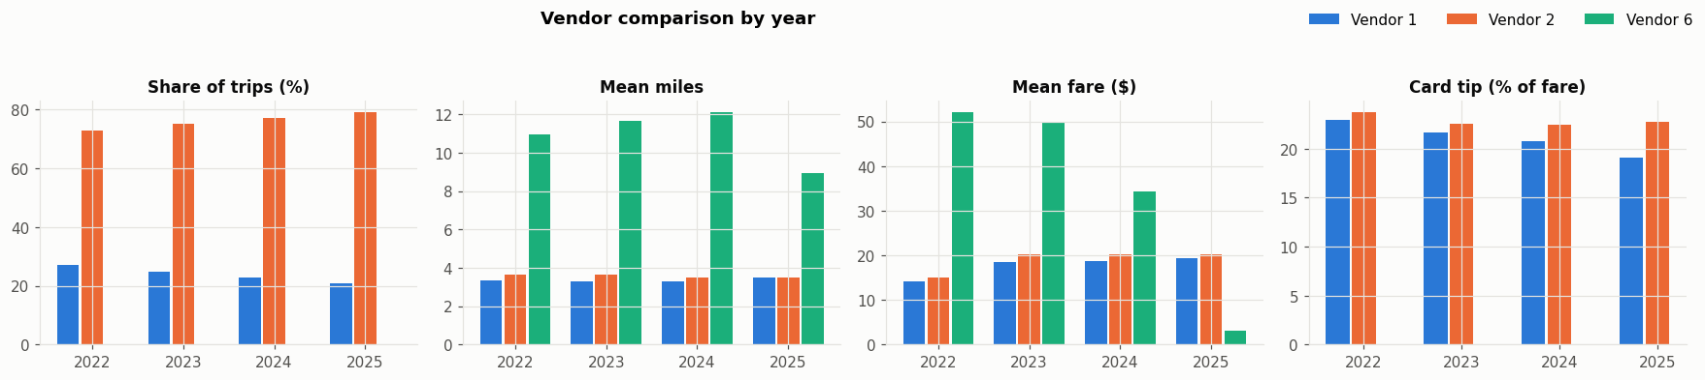
Consistent meters, but different weather each year
B · DATA CHECKS
 | 2022 | 2023 | 2024 | 2025
Rain days (≥ 1 mm) | 106 | 102 | 105 | 96
Total precipitation (mm) | 1,176 | 1,507 | 1,178 | 1,006
Snow days | 8 | 4 | 8 | 14
Total snowfall (mm) | 448 | 59 | 261 | 440
Mean max temp (°C) | 17.6 | 18.3 | 18.3 | 17.1
Freezing days | 16 | 1 | 6 | 14
Meter vendors Vendor 2 records 73–79% of trips. Vendors 1 and 2 have near-identical miles, fares and tips, so one meter system is not distorting results. Blank passenger counts rise to 17–21% in 2025 for both.
Weather by year 2025 had the most snow days and the least rain; 2023 was wettest but almost snow-free. Weather differs between the before and after years, so it is controlled in every model.
Notes:
Two data checks. Left: the two main meter vendors record very similar distances, fares and tips, so the data are consistent across meter systems; vendor 2 records about four in five trips. Right: weather differed across years, with 2025 the snowiest and driest, which is why weather is controlled in every model.

Slide 9
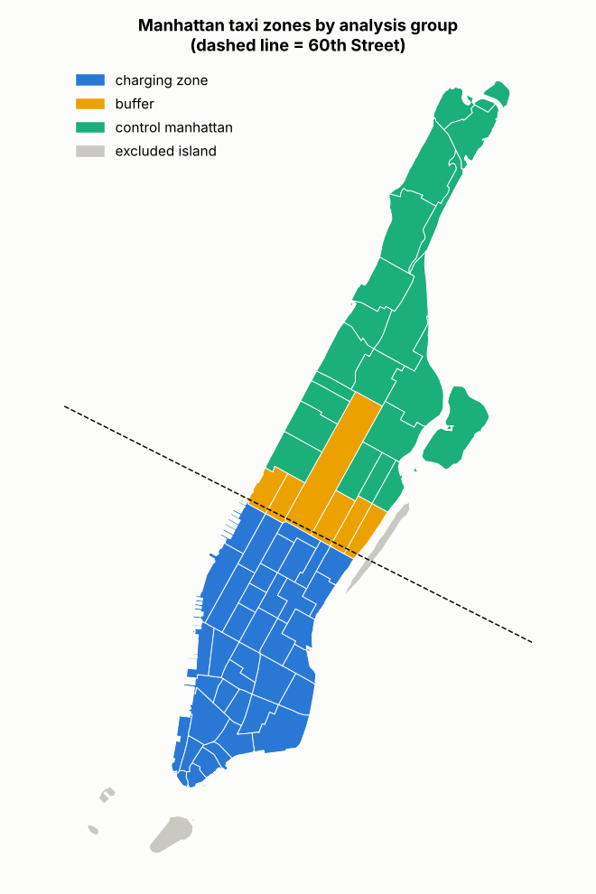
A natural experiment drawn along 60th Street
B · STUDY DESIGN
68.7k
98%
Charging zone
38 zones · Manhattan at and below 60th St
pickups a day, 2025
of trips paid the fee
16.7k
54%
Buffer
6 zones · The 59th–60th St strip
pickups a day, 2025
of trips paid the fee
18.3k
31.5%
Control
20 zones · North Manhattan, no toll
pickups a day, 2025
paid the fee → estimates are lower bounds
Notes:
Each taxi zone is assigned from the shapefile. The charging zone has 38 zones at and below 60th Street. The buffer has 6 zones straddling the line, kept separate because they are partly tolled. The control is 20 zones in north Manhattan with no toll. We rejected the outer boroughs as a control because their taxi demand followed a very different, airport-driven path. The control is not untouched: 31.5% of its trips paid the fee in 2025 because they travelled into the zone, so our estimates are lower bounds.

Slide 10
Four designs, from comparison to counterfactual
B · METHODOLOGY
1
RQ3
2
RQ4
3
RQ2
4
RQ5
Difference-in-differences
Triple difference
Fare-segment design
ML counterfactual
Δ charging zone − Δ north Manhattan
(peak − overnight) × (zone − control) × (post − pre)
Δ trips vs Δ price across 19 trip segments, net of placebo year
Train ≤ 2024 → predict 2025, minus 2024 placebo
Effect of the toll on speed and pickups, net of citywide shocks
Tests the mechanism: gains should be largest when the toll is $9
Relative demand response to the 2022 fare increase
Independent check with gradient boosting, random forest, ridge, Spark
Controls weather, holidays, weekday, month Inference Newey–West HAC, week-block bootstrap Tools PySpark · DuckDB · statsmodels · scikit-learn · Spark MLlib
Notes:
Difference-in-differences compares the before-after change in the charging zone with the change in north Manhattan, so citywide shocks cancel. The triple difference adds peak versus overnight hours: if the toll works by deterring cars, gains should be larger when the toll is $9. For the fare increase, different trip types got different percentage rises; we compare their demand changes against the same calendar windows a year later. Machine-learning models trained on 2022–24 forecast a no-toll 2025, adjusted by the same exercise on a fake 2024 toll. Weather, holidays, weekday and month are controlled throughout, with Newey–West or week-bootstrap standard errors.

Slide 11
Demand climbed to 120,000 trips a day in 2025
C · TAXI MARKET ACTIVITY
 | 2022 | 2023 | 2024 | 2025
Trips/day (k) | 104.5 | 101.3 | 107.4 | 120.3
Mean fare ($) | 14.80 | 19.81 | 19.82 | 20.04
Speed (mph) | 12.2 | 12.0 | 11.7 | 11.9
Distance (mi) | 3.56 | 3.53 | 3.43 | 3.49
Card share (%) | 76.7 | 79.6 | 76.0 | 68.6
Airport trips (%) | 10.1 | 11.1 | 10.2 | 8.9
Paid $0.75 fee (%) | 0 | 0 | 0 | 73.0
Fare increase
Toll begins
Source: TLC yellow-taxi records, cleaned; gap days excluded; all 48 months included.
Notes:
Average daily yellow-taxi trips by month. Demand dipped every January and summer, fell slightly after the fare increase in early 2023, and rose to a record level for this period in 2025, the year the toll began. This rise is a raw pattern: it includes changes in cleaning rates and seasonality, and is not by itself an effect of the toll. The table summarises each year.

Slide 12
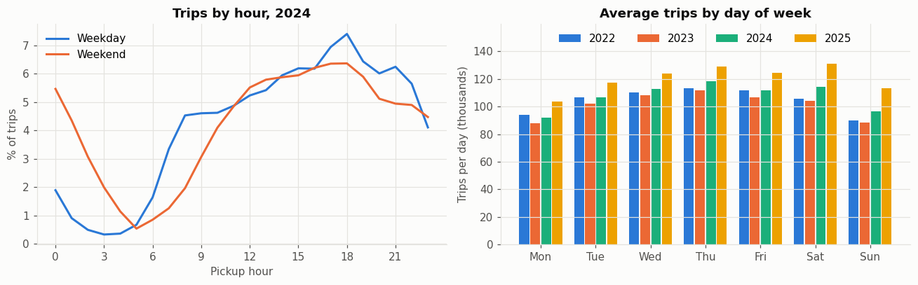
Weekdays peak at 6 pm; weekends peak after midnight
C · WHEN PEOPLE RIDE
WHAT WE DERIVE
1
On weekdays, trips climb through the day to a 6 pm peak, the hours when the $9 toll applies.
2
Weekends have a late-night peak around midnight to 2 am, when the toll is only $2.25.
3
Thursday to Saturday are busiest, and 2025 is the busiest year on every day of the week.
Notes:
Left: share of trips by pickup hour in 2024. Weekday demand peaks in the evening rush; weekend demand peaks late at night. Right: average trips by weekday for each year. These patterns line up with the toll schedule and motivate the peak-versus-overnight test.

Slide 13
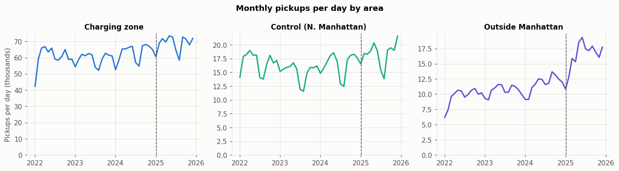
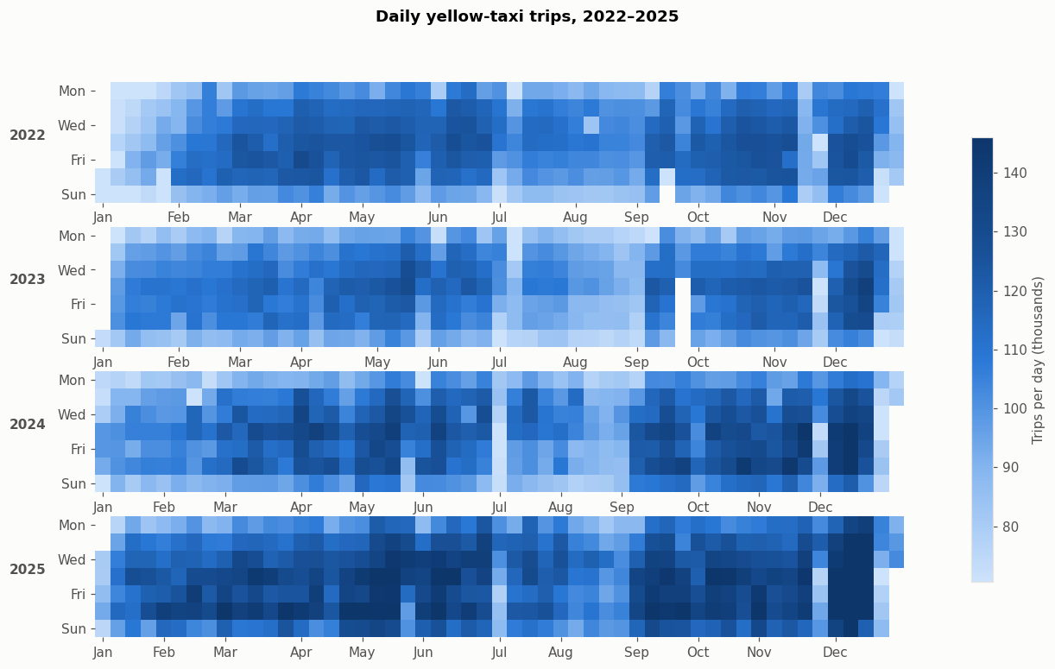
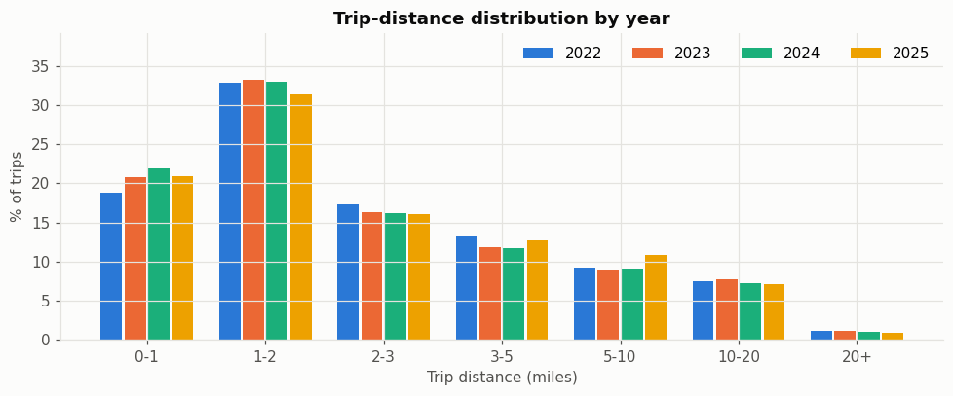
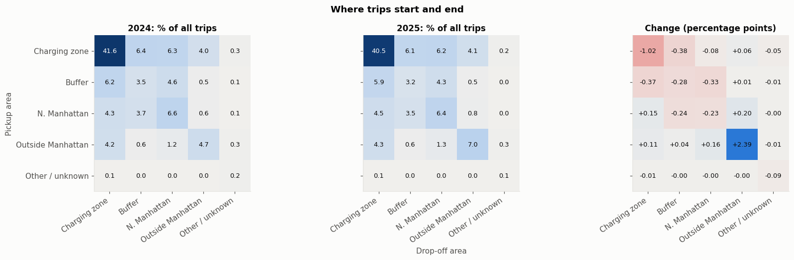
Taxis serve short Manhattan hops; outer-borough trips grew
C · WHO RIDES, WHERE AND HOW FAR
Every day, 2022–25.
Thursday–Saturday busiest, Sundays and Christmas quietest; white gaps are excluded missing-data days; 2025 darkest overall.
Pickups by area. The zone is steady at 60–70k a day; outside-Manhattan pickups rose from 7k to 17k, a different path, so outer boroughs cannot be the control.
Trip length. One trip in three is 1–2 miles and one in five under a mile, so a flat $0.75 fee is a big share of a short fare.
Where trips start and end. 41% of trips start and end inside the zone; the pattern barely moved in 2025 apart from more outer-borough trips (+2.4 pp).
Notes:
Four views of demand. Pickups by area show why the outer boroughs are not a fair comparison. The calendar heatmap shows weekly and seasonal rhythms and the excluded gap days. Short trips dominate, which matters for a flat per-trip fee. Two in five trips are entirely inside the zone, so taxis mostly measure traffic within it.

Slide 14
Fares stepped up once; revenue kept rising
C · FARES AND REVENUE
+34%
−3%
+29%
$3.47M
mean fare, 2022 → 2023
trips per day, 2022 → 2023
daily spending, 2022 → 2023
spent per day in 2025
Notes:
Left: mean meter fare per trip by month. The December 2022 increase shows as a single step from about $15 to about $19–20, after which fares were flat in nominal terms. Right: total passenger spending per day, in millions of dollars, including surcharges, tolls and tips. Revenue rose 29% from 2022 to 2023 even though trips fell about 3%, which is what inelastic demand implies. In 2025, the toll fee and higher demand pushed daily spending to about $3.5 million.

Slide 15
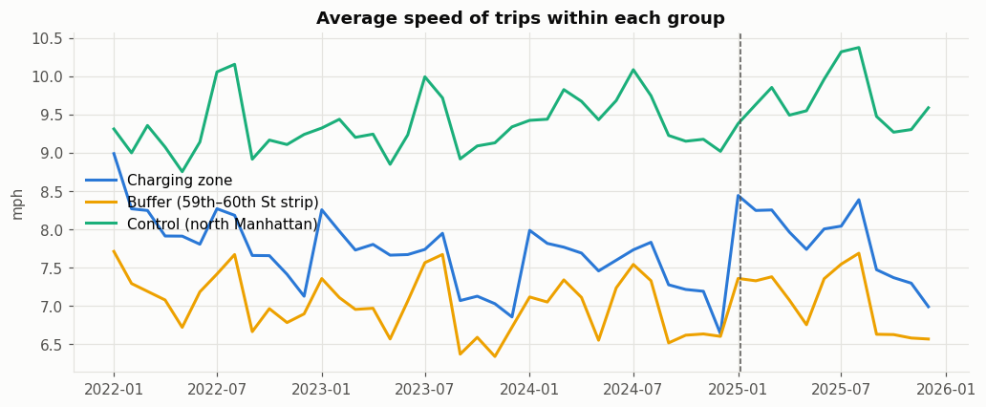
Zone speeds jumped in January 2025, then drifted back
C · SPEED BY AREA
WHAT WE DERIVE
1
North Manhattan is fastest (about 9–10 mph); the zone runs at 7–8 mph and the buffer strip is slowest.
2
Zone speeds stepped up sharply in January 2025 to about 8.4 mph, the highest level since early 2022.
3
By late 2025 the zone was back near 7 mph, the fading pattern confirmed formally in Section D.
Notes:
Average speed of trips that start and end inside each area, by month. The dashed line marks the toll. The visible jump in the charging zone in January 2025 and its gradual erosion are the raw signal behind the difference-in-differences estimates.

Slide 16
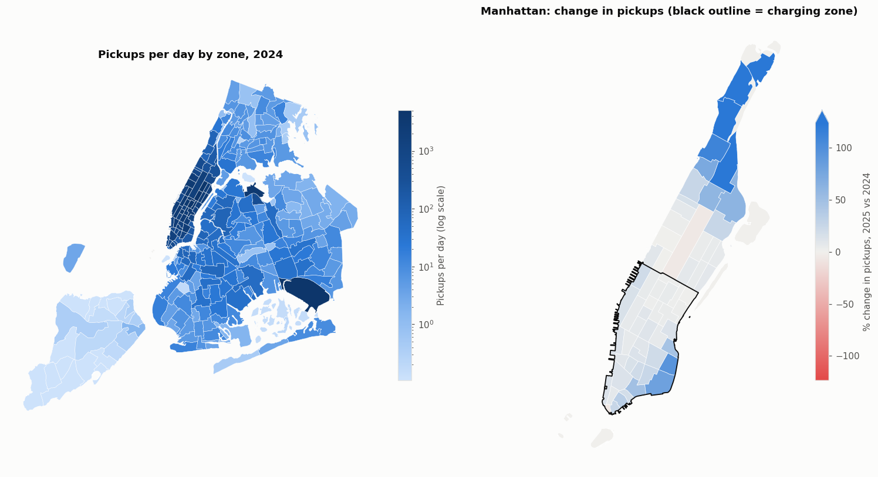
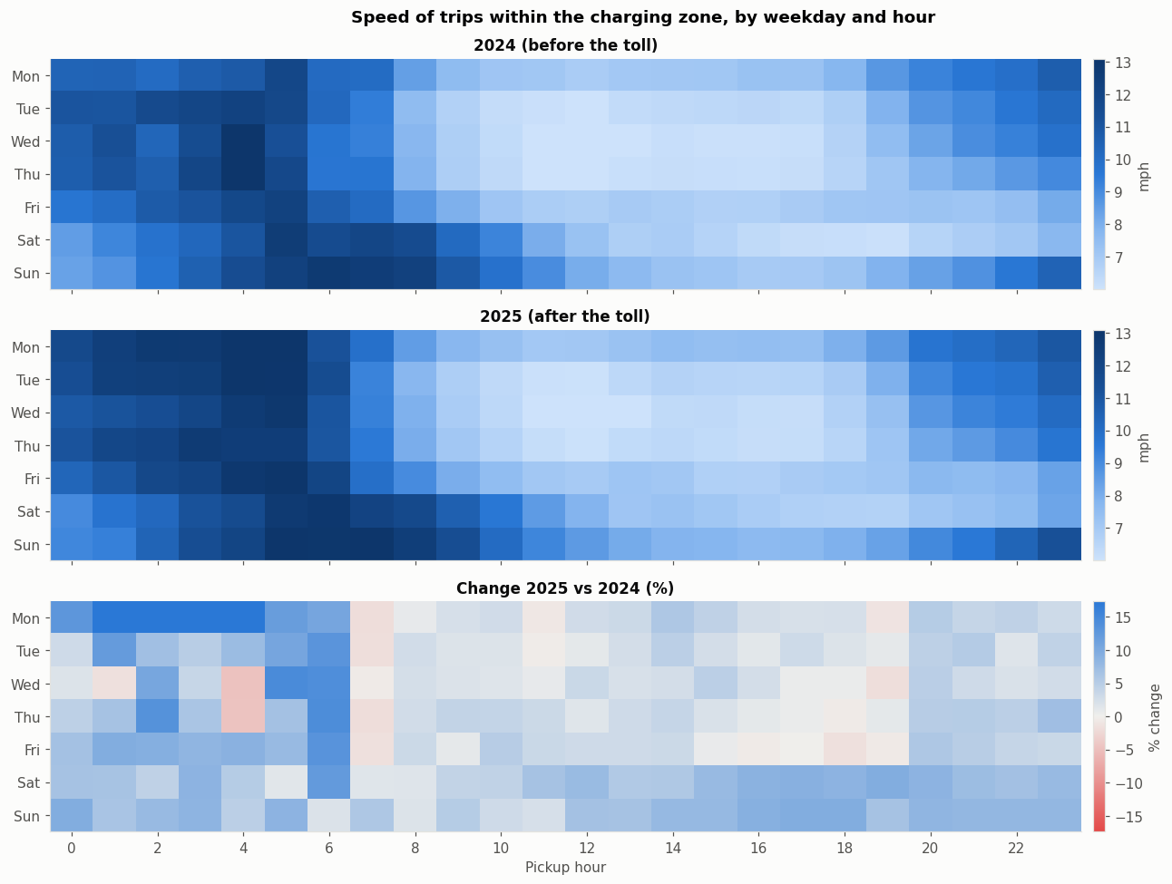
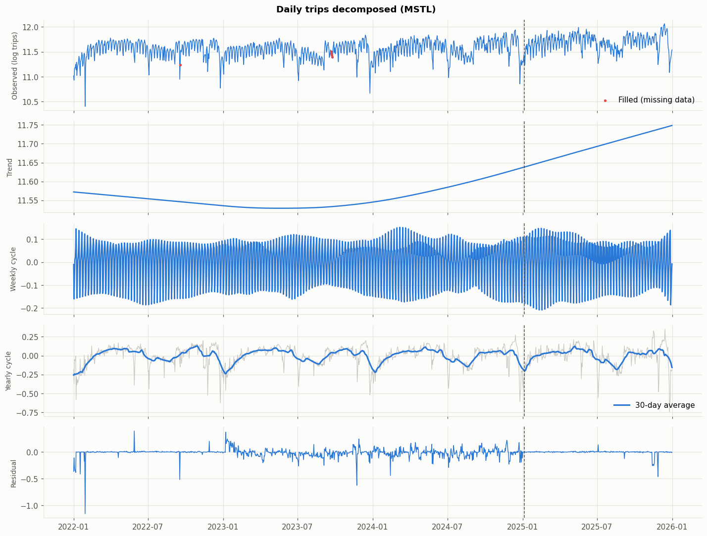
Raw patterns hint at the toll, but trends were moving
C · GEOGRAPHY, SPEED AND TREND
Maps.
Demand is concentrated in Manhattan and the airports; 2025 pickups grew 50–100% in upper Manhattan but barely changed inside the zone.
Change 2025 vs 2024 (%).
The zone got 4.4% faster, but the control also sped up and grew faster in pickups: raw changes are patterns, not effects.
Speed by hour.
About 13 mph before dawn, 7 mph at midday. Raw gains look largest at night, before allowing for each hour’s pre-trend.
Trend and seasons.
The trend rose through 2024, before the toll; strong weekly and yearly cycles mean weekday and month must be controlled.
Notes:
Geography, raw changes, speed by hour and the long-run trend. Each suggests a toll effect at first sight, but each also shows why a careful comparison is needed: the control changed too, hours had different trends, and demand was already rising.

Slide 17
Snow and holidays move demand; we control for both
C · REGRESSION: EVERYDAY DRIVERS
−0.9%
+16.5%
speed per cm of rain
speed on public holidays
Diagnostics, model (7)
R² | 0.60 trips · 0.74 speed
Durbin–Watson | 0.58 → autocorrelated errors
Breusch–Pagan | p < 0.001 → heteroskedastic
Ramsey RESET | p = 0.63 → form adequate
Max VIF | 5.7 (temperature)
Notes:
OLS of log daily trips on weather and calendar, with day-of-week, month and year effects, over 1,450 days. Each centimetre of new snow cuts trips by about 2.6% and each centimetre of lying snow by about 0.9%. Public holidays have about 19% fewer trips. Rain does not change daily trips but slows traffic by about 0.9% per centimetre, and holidays are about 16.5% faster. Diagnostics show strong autocorrelation and heteroskedasticity, so we use Newey–West standard errors; there is no sign of functional-form problems.

Slide 18
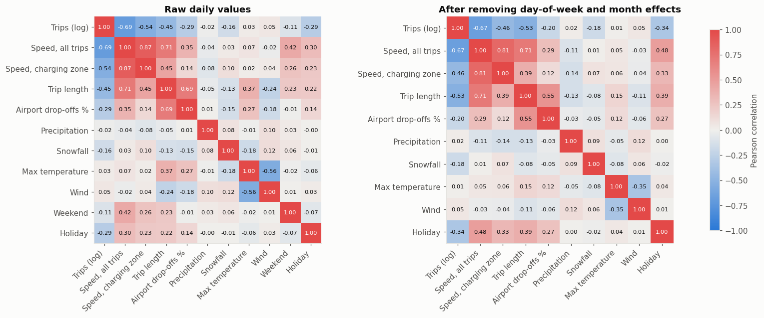
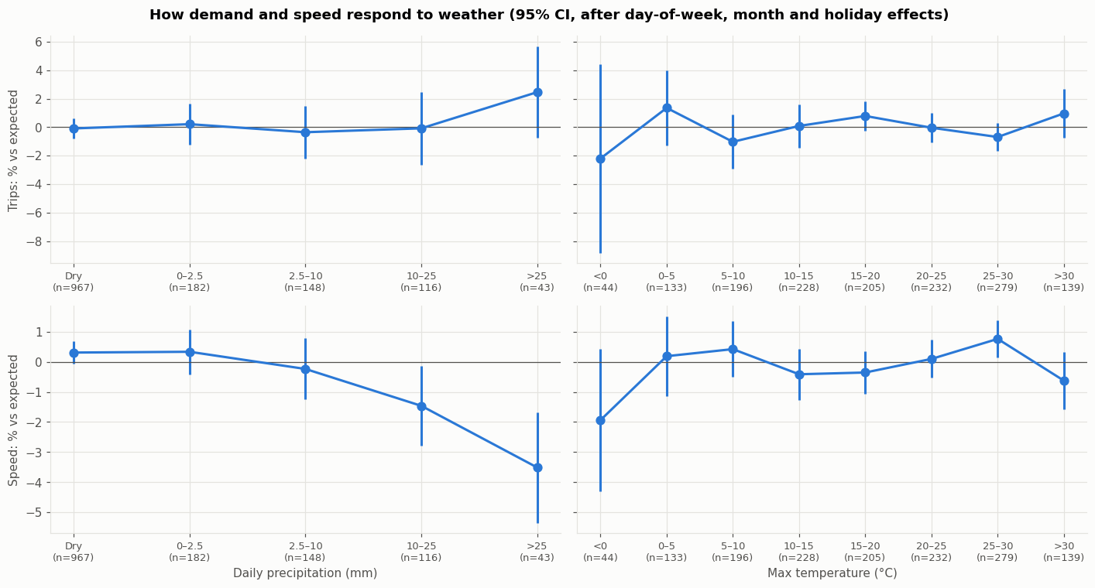
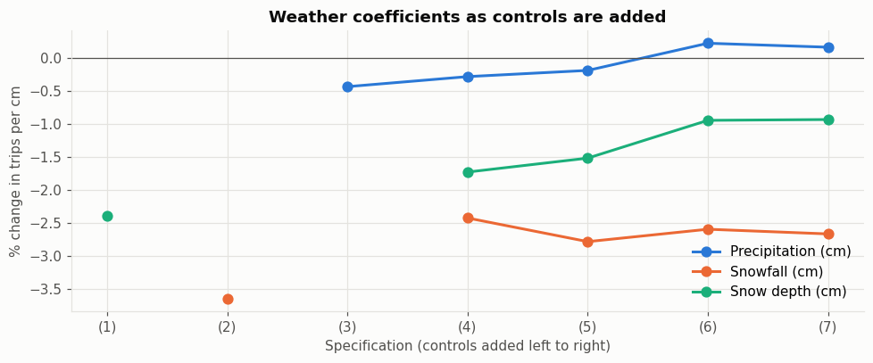
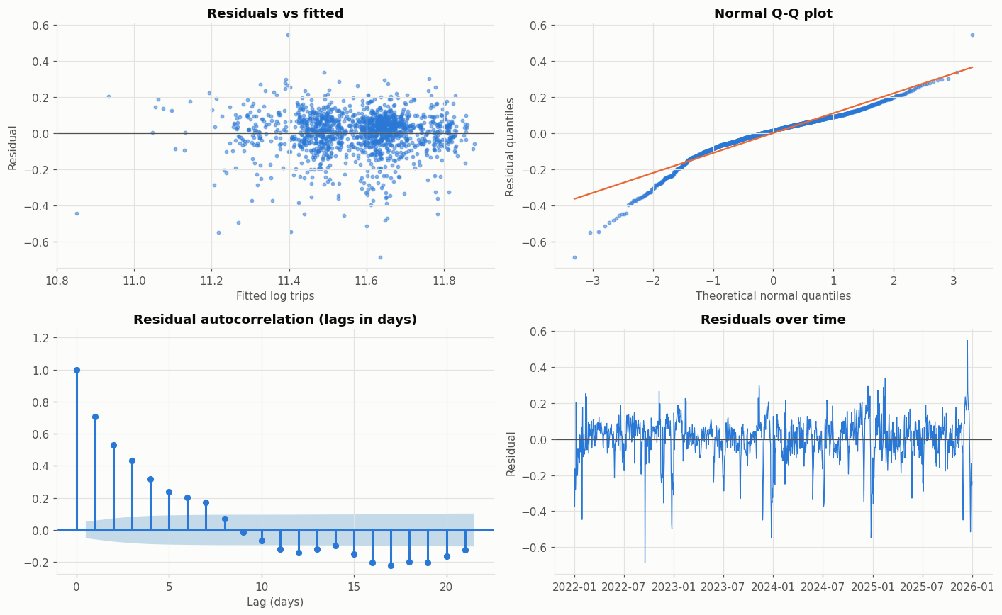
Weather effects are robust; errors need Newey–West
C · CHECKING THE REGRESSION
Weather bands.
Days with over 25 mm of rain are 3–4% slower while trips hold up; temperature has little effect.
Correlations. Busier days are slower (r = −0.69). After removing weekday and month, weather correlations shrink; holidays and snow remain.
Residuals.
Strong autocorrelation (DW 0.58) and a heavy left tail, so we use Newey–West errors; RESET p = 0.63.
Stability. Snowfall stays at −2.4% to −2.8% per cm across specifications; snow depth shrinks once month effects are added.
Notes:
Checks behind the regression: correlations guide which controls to include, weather bands show non-linear rain effects on speed, the coefficients are stable across seven specifications, and the residual diagnostics justify Newey–West standard errors.

Slide 19
Zone speeds rose about 1–3% relative to the control
D · RQ3 · SPEEDS
+1 to +3%
credible range: a lower bound, since the control partly benefited
Yellow bars: specifications whose baseline or adjustment best handles the pre-trend.
Grey bars: bounds. The zone was slowing 3.8% a year before the toll; ignoring this understates the effect, extrapolating it overstates it.
Notes:
Estimates of the effect of the toll on the speed of trips inside the charging zone, relative to north Manhattan, from six specifications. Before the toll, the zone had been slowing relative to the control by about 3.8% a year as offices refilled, so no specification fully passes the parallel-trends test. Using all of 2022–24 as the baseline pulls the estimate below zero; correcting for the trend pushes it to 5.4–6.9%. The credible range, supported by the ML and Spark checks, is about 1 to 3%. Because 31.5% of control trips also paid the fee, this is a lower bound.

Slide 20
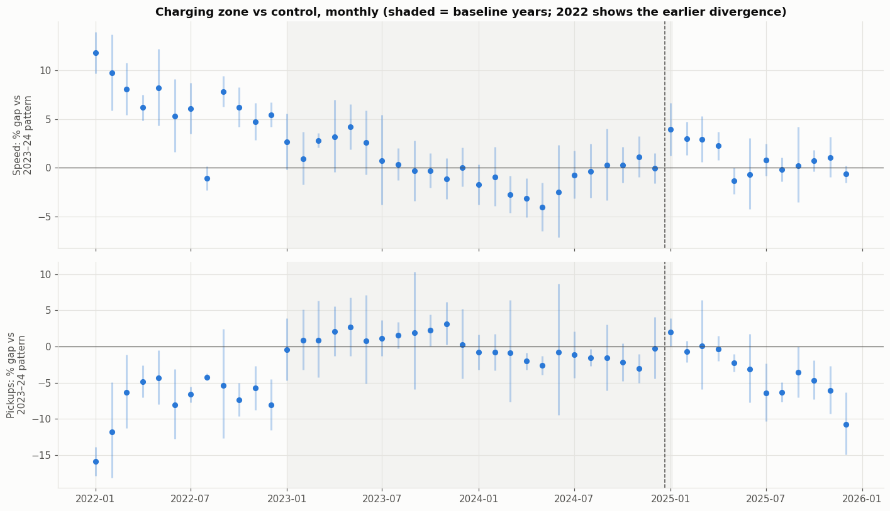
Against 2023–24, speeds jumped 3–4% right after the toll
D · RQ3 · LONGER BASELINE
WHAT WE DERIVE
1
Speeds in the zone were 3–4% above the 2023–24 pattern in January–April 2025, then returned to about zero by mid-year.
2
Pickups held up at first, then fell to 5–11% below the pattern in the second half of 2025.
3
In 2022 the zone was far above the 2023–24 pattern, an earlier divergence, which is why 2022 is not used as a baseline.
Notes:
Monthly gaps between the charging zone and north Manhattan relative to the 2023–24 baseline (shaded). The early speed gain that fades, and the later fall in pickups, are both visible.

Slide 21
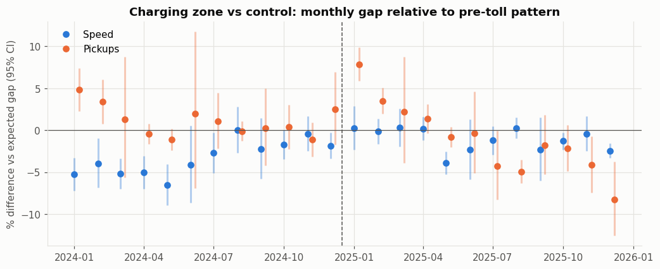
The speed gain was concentrated in the first half of 2025
D · RQ4 · TIMING IN DETAIL
Month by month, 2024 baseline. Speeds ran 2–6% below the expected gap in 2024 and moved to about zero after the toll; pickups fell below the control from mid-2025.
First vs second half. 4.7% in January–June against 0.3% in July–December (2024 baseline). London’s gains also faded; Stockholm’s lasted.
Notes:
Two views of timing. The monthly chart shows the zone catching up with the control after the toll, and pickups falling later in the year. The half-year split quantifies the fade: most of the speed gain came in the first six months.

Slide 22
Pickups fell most just outside the boundary
D · RQ3–4 · PICKUPS AND SPILLOVER
−2 to −5%
pickups in the charging zone
−6 to −8%
pickups in the buffer strip; parallel pre-trends (p = 0.86)
ML forecast estimated for the charging zone only.
Notes:
Effect of the toll on taxi pickups relative to north Manhattan. In the charging zone pickups fell about 2–5%, depending on the baseline and method. In the buffer strip around 59th–60th Street they fell 6–8%, and this estimate is the most robust: the buffer and control had parallel pre-trends. Buffer trips are often short hops into the zone, for which a $0.75 fee is a large share of the fare. 54% of buffer trips paid the fee in 2025.

Slide 23
Speeds rose most when the toll was highest
D · RQ4 · MECHANISM
+3.9 pp
peak − overnight, 2022–24 baseline
p = 0.004 · placebo p = 0.45
+4.5 pp
peak − overnight, 2023–24 baseline
p = 0.014 · placebo p = 0.34
Notes:
The triple difference compares peak hours, when cars pay $9, with overnight hours, when they pay $2.25. Allowing peak and overnight traffic their own pre-toll trends, peak-hour speeds in the zone rose 3.9 percentage points more than overnight speeds with the 2022–24 baseline (p = 0.004), and 4.5 points more with 2023–24 (p = 0.014). The same test on a fake toll date in January 2024 finds nothing (p = 0.45 and 0.34). This is the strongest evidence that the toll itself caused the change.

Slide 24
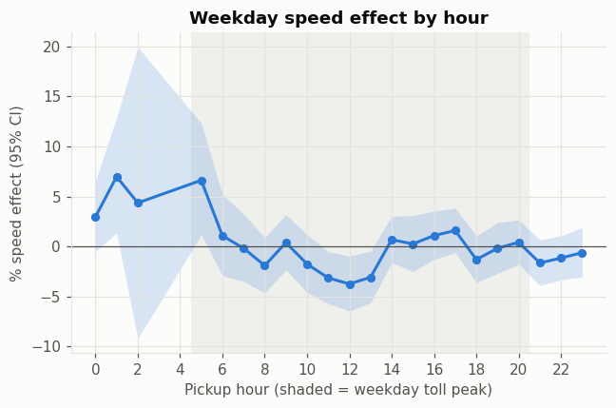
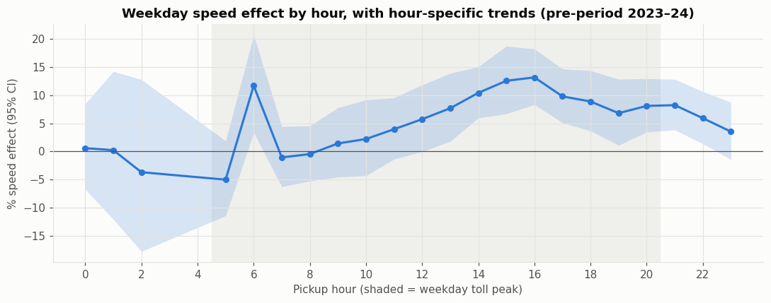
With hour-specific trends, gains peak in the afternoon rush
D · RQ4 · HOUR BY HOUR
WHAT WE DERIVE
1
Left, no trends: gains appear only overnight, because toll hours had been slowing faster before the toll.
2
Right, hour-specific trends: the effect rises through the toll period to about +10–13% at 3–5 pm.
3
Outside toll hours effects are small or negative, matching the toll schedule: the clearest picture of the mechanism.
Notes:
Weekday speed effect by pickup hour; the shaded band is the weekday toll peak. Without trends the pattern is misleading because peak hours were already on a different path. Allowing each hour its own pre-trend, gains concentrate in the hours when the $9 toll applies.

Slide 25
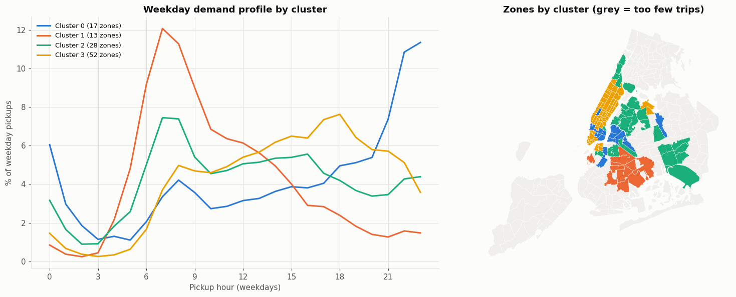
Four kinds of taxi neighbourhood, each with its own rhythm
D · RQ4 · KINDS OF NEIGHBOURHOOD
1
2
Nightlife
17 zones · 162 pickups/day
48% of trips at night
Residential
13 zones · 30 pickups/day
23% at 7–10 am
3
4
Daily rhythm and map. Residential zones peak at 7–8 am, nightlife after 9 pm; the core peaks in the evening rush, the $9 toll hours.
Airports and edges
28 zones · 34 pickups/day
6.1 mi, 14 mph trips
Manhattan core
52 zones · 1,471 pickups/day
20% at 4–8 pm; 28 in the zone
k-means, k = 4. Clusters from 2024 hourly profiles, volume, trip length, speed and airport share (silhouette 0.32).
Notes:
Unsupervised clustering of zones gives four interpretable types. The Manhattan core holds 28 of the 38 charging-zone zones and peaks in exactly the hours the toll targets. The clusters were used to pick look-alike control zones for a matched-control check.

Slide 26
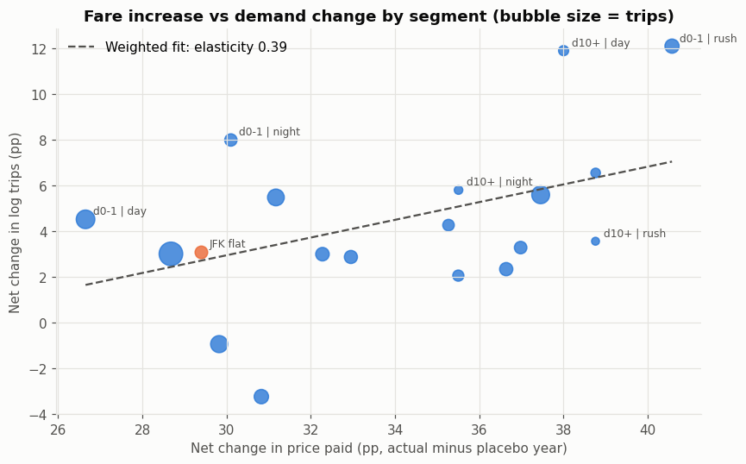
Higher fares did not measurably cut taxi demand
D · RQ2 · FARE INCREASE
Raw changes. Every trip type got 23–35% dearer; trips fell most for JFK, but winter seasonality explains much of the drop.
Segments, net of a placebo year. Bigger fare rises did not bring bigger demand falls (slope +0.39, CI 0.04 to 0.80; −0.70 without the placebo).
Verdict no measurable demand response; revenue rose 29% while trips fell 3%, consistent with inelastic demand (Schaller 1999: −0.22).
Notes:
Left: raw change in mean fare and trips per day around the December 2022 increase, by trip type; much of the winter fall in trips is seasonal. Right: the formal design, with 19 trip segments’ net fare rise against net change in trips, both relative to the same windows a year later. Segments with larger rises did not lose more riders. The relative elasticity is +0.39 net of the placebo year and −0.70 without it, so we report it as inconclusive, consistent with inelastic demand (Schaller 1999, −0.22) and with revenue rising 29%.

Slide 27
Machine learning and Spark reach the same answer
D · RQ5 · MACHINE LEARNING AND BIG DATA
Model | Test R² (speed) | Speed effect | Pickup effect
Gradient boosting | 0.63 | +0.9% [0.1, 1.7] | −4.8% [−6.5, −3.1]
Random forest | 0.62 | +1.0% [0.3, 1.8] | −4.7% [−6.4, −2.9]
Ridge regression | 0.62 | +1.0% [0.3, 1.7] | −5.2% [−6.9, −3.7]
Spark MLlib GBT (trip level) | 0.81 | +2.4% [0.9, 4.1] | –
Placebo-adjusted, vs north Manhattan; 95% intervals in brackets. Spark rows and timings are from the run before Dec 2023 was restored.
0.91
$3.58
identical
R² of a pre-trip fare model
fare per extra mile (official $3.50)
KPIs from Spark and DuckDB
Notes:
Three models trained on 2022–24 predict a no-toll 2025 for each zone and day; the gap from what happened, minus the same exercise on a fake 2024 toll, is the effect. All three give speed gains of about 1% and pickup falls of about 5%. On the test year they beat simple seasonal baselines. Spark MLlib gradient boosting on 1.7 million sampled trips gives a 2.4% trip-level speed gain. On engines, Spark and DuckDB return identical results over 154.7 million trips; DuckDB is fastest once files are cached. Timings are from the run before December 2023 was restored.

Slide 28
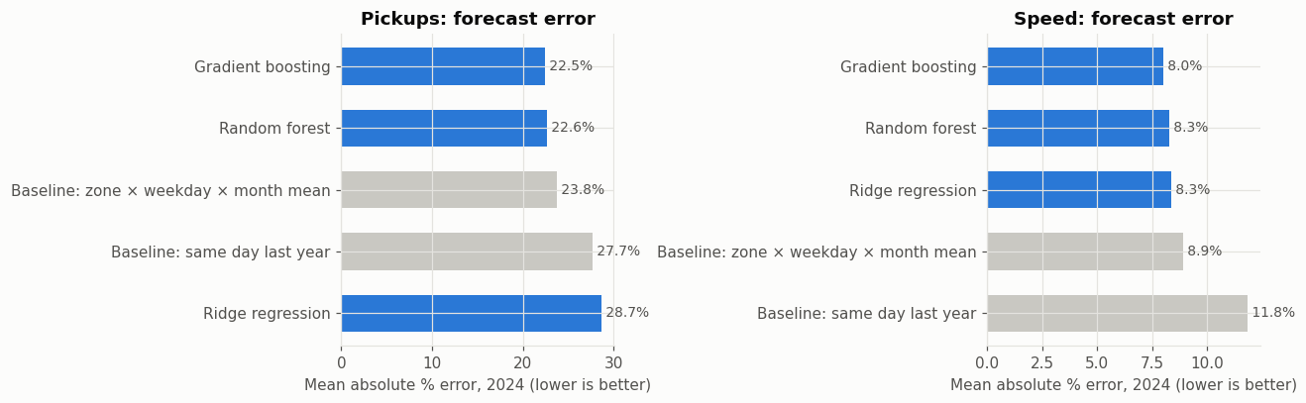
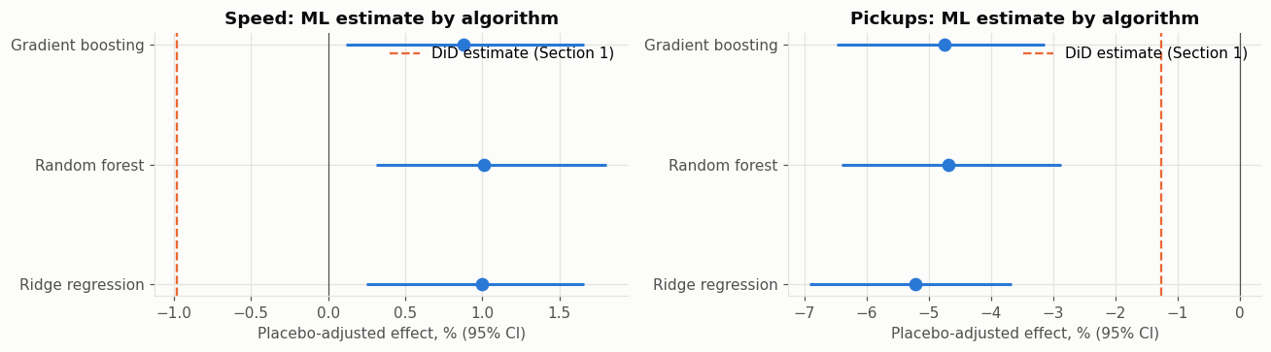
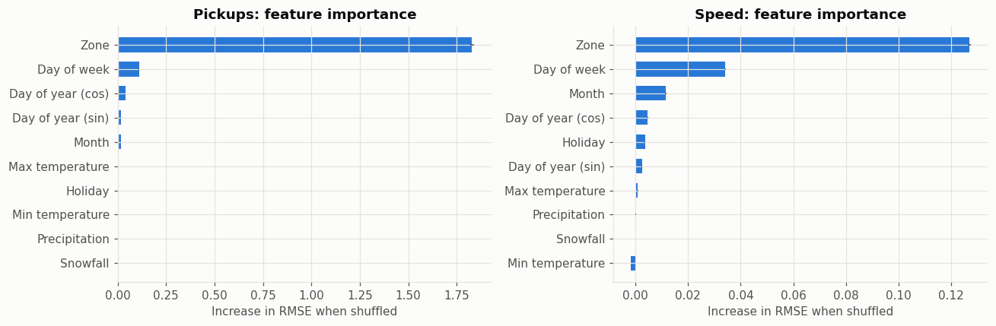
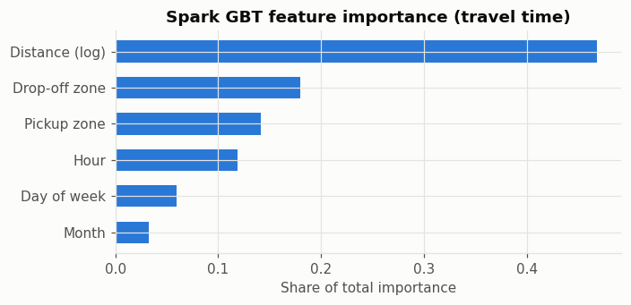
Tree models forecast best and agree on the effect
D · RQ5 · MACHINE LEARNING IN DETAIL
Forecast accuracy. Gradient boosting and random forest beat both seasonal baselines on 2024 (speed error 8.0% vs 8.9%).
Estimates by algorithm. All three give speeds +0.9 to +1.0% and pickups −4.7 to −5.2%, above the naive DiD line for speed.
Spark GBT, trip level.
Distance explains 47% of travel time, zones 32% and hour of day 12%: the congestion signal.
What drives the forecasts. Zone identity dominates, then weekday and month; weather adds almost nothing at the daily level.
Notes:
Four checks on the machine-learning work: accuracy against simple baselines, agreement across algorithms, feature importance in the daily models, and the Spark trip-level model of travel time. Location and time of day, not weather, drive the predictions.

Slide 29
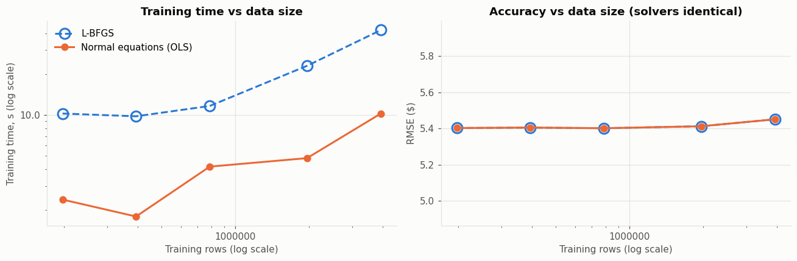
Spark training time grows slower than the data
D · BIG DATA PERFORMANCE
WHAT WE DERIVE
1
Training time grows with about the square root of the rows (exponent ≈ 0.5) for both solvers.
2
Accuracy is flat beyond 200,000 rows: more data does not reduce error for this linear fare model.
3
Closed-form normal equations are about 4× faster than L-BFGS at every size, with identical results.
Notes:
Spark MLlib linear regression on samples from 0.2 to 3.9 million trips, extending the Rhouas and El Hami (2025) solver comparison. Spark outputs are from the run before December 2023 was restored.

Slide 30
What we observe, and what we can attribute to policy
D · RQ5 · PATTERNS VS CAUSAL EFFECTS
Observed patterns
Causal-leaning estimates
raw before–after changes
comparison group + pre-trend and placebo tests
+12%
trips per day, 2025 vs 2024
+1 to 3%
speed in the zone vs control (lower bound)
+3.9 to 4.5 pp
peak minus overnight speed gain
+34%
mean fare, 2022 → 2023
−6 to −8%
pickups in the buffer strip
+4.4%
speed inside the zone, 2025 vs 2024
−2 to −5%
pickups in the charging zone
+9.2%
pickups in the zone, 2025 vs 2024
Inconclusive
fare elasticity after the 2022 rise
Notes:
Left column: raw changes that anyone can read off the data; they mix the policies with trends, seasonality and data changes. Right column: estimates that net out a comparison group and pass, or are bounded by, placebo and pre-trend tests. The dots show our confidence. The direction of the speed effect, the peak-hour mechanism and the buffer pickup fall are robust; the exact size of the speed effect and the fare elasticity are not.

Slide 31
Same direction as the evidence, smaller in size
E · CONSISTENCY WITH LITERATURE
Study | Finding | Our result | Verdict
Cook et al. (2025), NBER WP 33584 | Zone speeds up ~15% in early weeks; peak gains larger | Same direction and peak pattern; smaller size (partly treated control, door-to-door speeds, full year) | Consistent
Transport for London | Congestion back to pre-charge levels by ~2008 | Our gain faded in the second half of 2025 | Consistent
Eliasson (2014), Stockholm | Traffic −20%, reduction persisted | Too early to tell for New York | Open question
Schaller (1999), NYC taxis | Fare elasticity about −0.22 | No measurable demand fall; revenue up 29% | Consistent
Notes:
Cook and co-authors (NBER 2025), using Google Maps road speeds, found speeds in the zone rose about 15% in the first weeks, with larger peak gains. We match the direction and the peak-hour pattern. Our estimate is smaller because our control area partly benefited, taxi speeds are door to door, and we average over a full year. London’s gains faded within a few years and Stockholm’s persisted. Schaller’s elasticity of −0.22 fits our finding that the fare increase did not reduce demand measurably.

Slide 32
What the results cannot claim
E · LIMITATIONS
1
2
3
Non-parallel pre-trends
Partly treated control
2025 data changes
No specification fully passes; effects are a range.
31.5% of control trips paid the fee: lower bounds.
Removal rate 4.5% → 9.9%; passenger count often blank.
4
5
6
Zones, not streets
Yellow taxis only
Short horizon, relative fares
Toll-free FDR Drive and West Side Highway not separated.
Uber and Lyft, the larger market, are not observed.
One post-toll year; relative, not total, fare effects.
Notes:
Six limitations. Pre-trends are not parallel, so the speed effect is a range. The control is partly treated, so estimates are lower bounds. 2025 data changed: the cleaning removal rate doubled and passenger counts are often missing, which mainly affects volume measures. Locations are zones, not streets, so the toll-free riverside highways cannot be separated. Only yellow taxis are observed, not Uber or Lyft. Only one post-toll year is available, and the fare design measures relative, not total, demand responses.

Slide 33
Lessons that transfer, under conditions
E · LESSONS FOR INDIAN CITIES
From New York
Condition for Indian cities
1
Price the peak, when congestion is worst
FASTag and number-plate cameras make time-of-day charging enforceable
2
Gains can fade within a year
Pair charges with better buses and metro; protect freed road space
3
Charge private vehicles, not shared rides
A $0.75 taxi fee barely moved demand; cover two-wheelers and autos
4
Regulated fare rises need not collapse demand
App-based fares differ: 2025 MoRTH guidelines allow surge up to 2× base fare
5
Evaluation needs trip-level data
Require aggregators and meters to share anonymised trip records
Indian context: Ministry of Road Transport and Highways, Motor Vehicle Aggregator Guidelines 2025.
Notes:
Lessons for Indian cities are conditional because traffic mix, enforcement and fare-setting differ. Peak pricing targets congestion where it matters, and FASTag and number-plate cameras make time-of-day charging enforceable. Gains can fade, so pair charges with public transport and protect freed road space. The burden should fall on private vehicles, including two-wheelers. India’s app-based fares differ: the 2025 aggregator guidelines allow surge up to twice the base fare. And evaluation needs anonymised trip-level data.

Slide 34
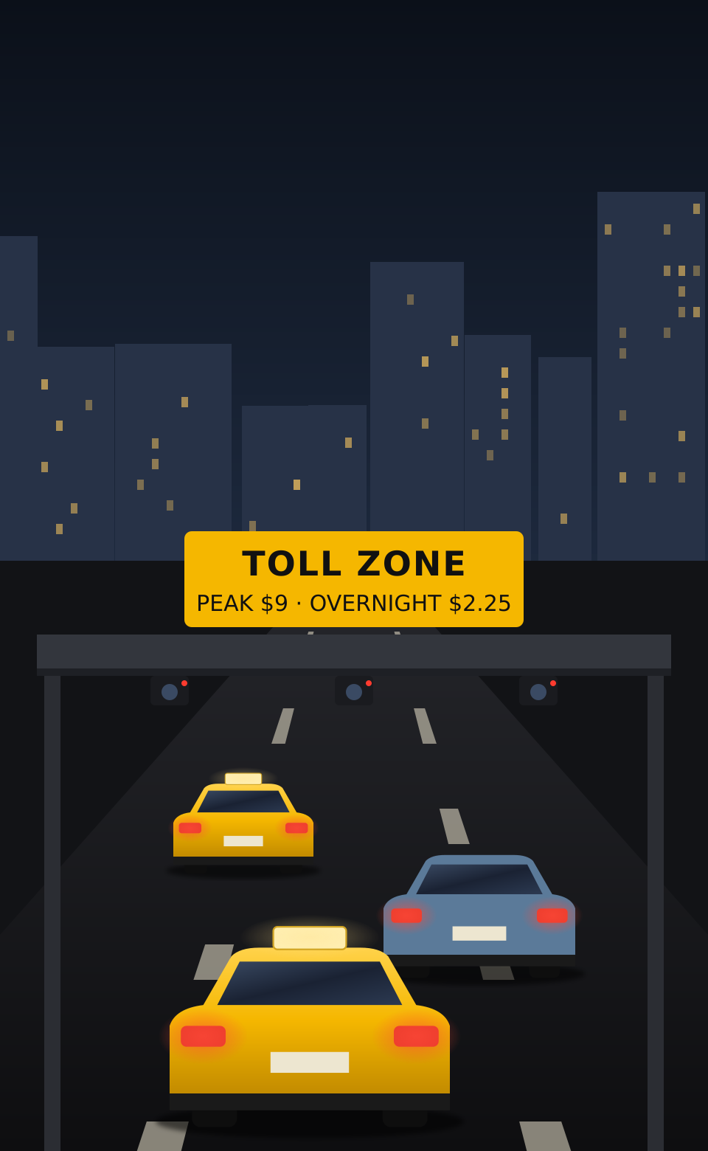
CONCLUSIONS
What the evidence says
+1–3%
Congestion pricing modestly sped up taxi travel in the zone, mostly in early 2025 (a lower bound).
+4 pp
Gains were larger at peak, when the toll is $9: the toll, not something else, drove them.
−6 to −8%
Pickups fell most just outside the boundary; inside the zone, 2–5%.
≈ 0
The 2022 fare rise brought no measurable fall in demand; revenue rose 29%.
Notes:
Four conclusions. One: congestion pricing modestly sped up taxi travel in the zone, about 1–3% relative to north Manhattan, a lower bound, mostly in early 2025. Two: gains were about 4 points larger at peak, when the toll is highest, which supports a causal reading. Three: pickups fell slightly in the zone and more just outside it. Four: the 2022 fare increase brought no measurable relative fall in demand while revenue rose, consistent with inelastic taxi demand. The illustration on the right can be swapped for a photo.

Slide 35

Thank you
Questions and discussion
Data: NYC Taxi & Limousine Commission trip records 2022–2025 · NOAA daily weather, Central Park · TLC taxi zone shapefile
[Student name] · [Email] · [Institution]
Notes:
Thank the audience. Likely questions: why north Manhattan as the control (outer boroughs diverged; the control is partly treated, so estimates are lower bounds); why the effect is smaller than Cook et al. (within-city control, door-to-door speeds, full year); why no fare elasticity is reported (the sign changes across specifications). The background illustration shows Central Park at dusk.

